Slide 1

Web Software Model
Lec 4 CS 4640 Programming Languages for Web Applications

Slide 2
Web Applications
User interactive software programs, deployed on a web server, accessed via a web browser
Use enabling technologies to
Make web site contents dynamic
Allow users of the system to implement business logic on the server
Let users affect state on the server
Constructed from diverse, distributed, and dynamically generated web components
Web components are software modules that implement different parts of the application’s functionality
An enabling technology makes web pages interactive and responsive to user input

Slide 3
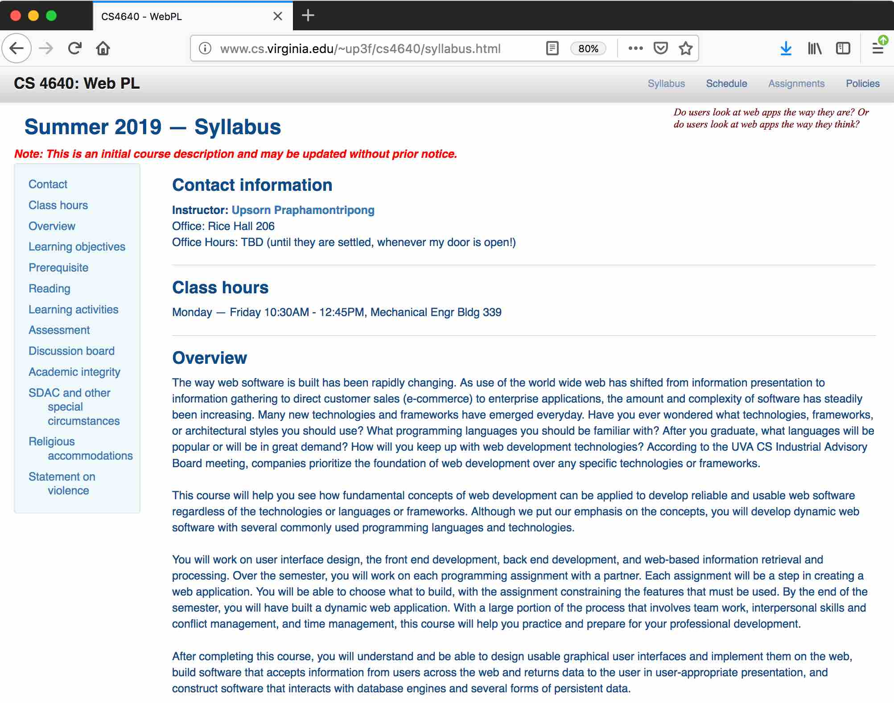
Web Browsers and Objects
Object type: Window
Properties
Location: http://www.ce.iug.edu/~up3f/ce5640/syllabus.html
Object type: Document
Properties
URL: http://www.ce.iug.edu/~up3f/ce5640/syllabus.html
lastModified: 06/01/2019 10:19:23
Title: Ce5640: WebPL

Slide 4
BOM: Browser Object Model
BOM – collection of objects that the browser makes available to us for use with JavaScript
window Object
document Object
location Object
history Object
document Object
navigator Object
screen Object
DOM
…
form Object
… …
form Object
link Object
link Object
image Object
image Object

Slide 5
DOM: Document Object Model
Object type: Document
Properties
URL: http://www.cs.virginia.edu/~up3f/cs4640/syllabus.html
lastModified: 06/01/2019 10:19:23
Title: CS4640: WebPL
Event Happens when
Load page and content have finished loading
Click user clicks the mouse over the page
Keypress user presses down on a key
Method What it does
write() adds content to the document
getElementById() accesses an element of a given id attribute

Slide 6
How A Browser See A Web Page
document
The browser receives an HTML page
<html>
<head>
<body>
It creates a model of the page and stores it in memory
<meta>
<title>
<link>
<a>
<header>
<div>
<div>
http-equiv content-type
Content text/html
...
CS4640: WebPL
rel stylesheet
href styles/cs4640-style.css ...
name top
<nav>
<div>
<div>
class container bottom ...
<a>
class navbar ...
<button>
It shows the page on screen using a rendering engine
class
main ...
<h3>
href #top
class btn
role button ...
Top
class sidebar ...
<ul>
id
contact
Contact Information

Slide 7
Server Side Processing
HTTP Request
data
XAMPP
Web server
UI implemented in a browser
Container engine
Program components
Client
Server
HTML
HTTP Response

Slide 8
General Design Issues
Separation of concerns: design goals of web app design
Presentation
Logic
Data
Seven criteria the design should support:
Reliability
Usability
Security
Availability (and also Accessibility)
Scalability
Maintainability
Performance and Time to market

Slide 9
Separation of Concerns
Presentation
Logic
Data
Data content
Data representation
Data storage
HTML, view
Functions and classes, software
Classes, objects
Data structure, classes, objects
Database and files, Oracle, SQL, NoSQL
Assumptions about data
Data values: contents of memory – change very frequently (during execution)
Data presentation: how the data are presented – change occasionally
Data structure: types, organization and relationships of different data elements, changes infrequently

Slide 10
Architectural Styles
How to partition a system
How components identify and communicate with each other
How information is communicated
How elements of a system can evolve
Web architectural styles constantly change
The goal is to separate logic from presentation and
to separate as many concerns in the logic as possible

Slide 11
Multi-Tiered Architectures
Each software layer only communicates with adjacent layers
HTML, view
Presentation layer
Communicates
with users
Classes, objects
Web-specific libraries
Business logic layer
Algorithms
Business Processing
Most software is here
Data layer
Data Reading and Writing
Separate concerns
Data storage
DB, XML, Data files
Other software
Enables distribution

Slide 12

Page-centric Design
Server
Web client
Request
Response
Main component
(Client requests are intercepted here)
Web client
Uses or instantiates
Database
Component
(data)
Web client
Component
(data)
Requests are made to a main component and the main component response to clients – “client-server”

Slide 13

Dispatcher (N-tier) Design
Server
Web client
Request
Response
Dispatcher
Web client
Database
Component
presentation
Data
Business processing
Usually use forward
Component presentation
Data
Web client
Component presentation
Requests are sent to a dispatcher that then forward the requests to another component (using forward or redirect control connection)

Slide 14
Model View Controller
An abstraction frequently used in web app design
Provide a way to divide the responsibilities of objects
Decreases coupling between objects and layers (supports easier maintenance)
Help divide the work (supports development expertise areas)

Slide 15
Model View Controller (2)
method calls
data structures
Model
events
Encapsulates application state
Responds to state queries
Exposes application functionality
Notifies views of changes
state change
state query
Components
change notification
HTML / JSP / PHP (view) / frontend
View
Controller
Renders the model
Requests updates from the model
Sends user inputs to controller
Allows controller to select view
view select
Defines application behavior
Maps user actions to model updates
Selects a view for response
One view for each function
user input
[Graphic from Designing Enterprise Applications with the Java 2 Platform,
Enterprise Edition, Nicholas Kassem et al., October 2000]

Slide 16
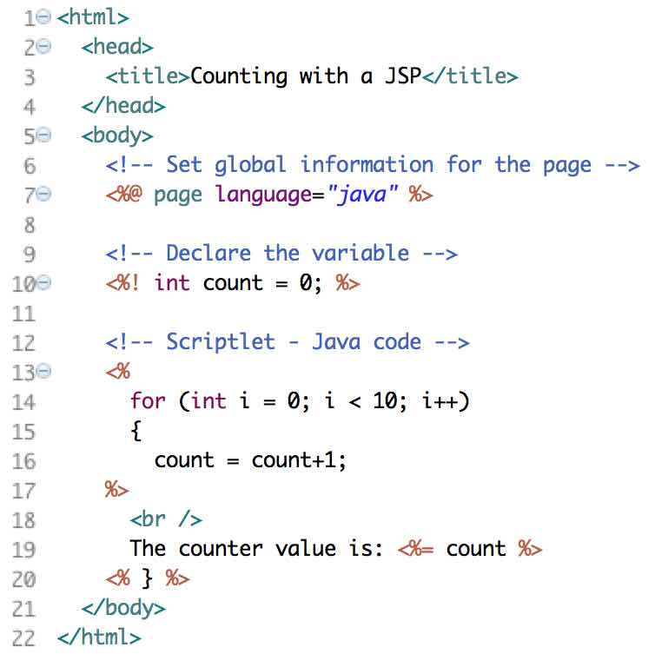
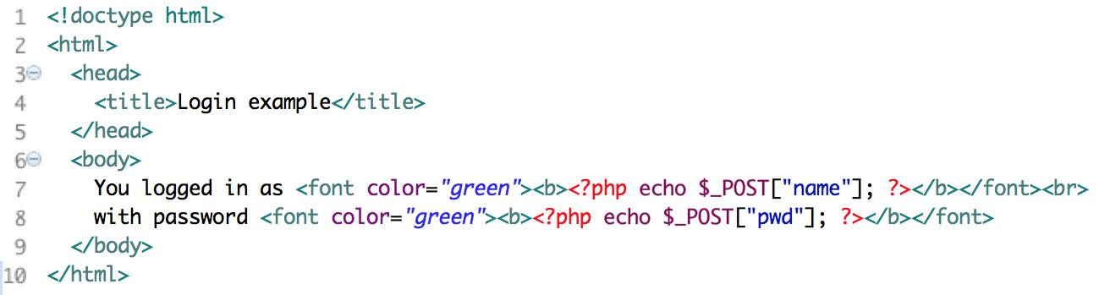
Server-Side Scripting
Generate HTML on the server through scripts
Early approaches emphasized embedding server code inside HTML pages
Examples: PHP, JSP
JSP
PHP

Slide 17
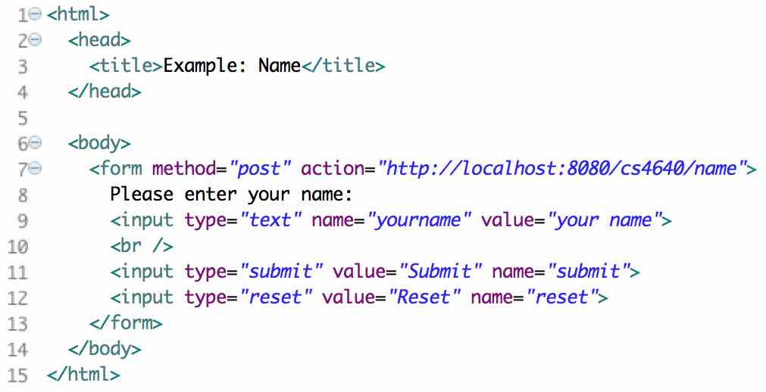
Server-Side Scripting Site
Browser
HTML
HTTP request
HTTP response
Web server
HTML templates, server logic,
load and store state to database
Database
Advantages
Server-side processing, browser independent, search optimization improvement, increased security
Disadvantages
Poor modularity, hard to understand, difficult to maintain

Slide 18
Server-Side Framework
Structure server into tiers, organizes logic into classes
Execution on the server
Can be single-page or multiple pages with page-centric design, dispatcher design, model-view-control design, or combination of any architectures
Example: JSP (with separation of concerns)
Presentation
Logic
Data
Data content
Data representation
Data storage
HTML and JSP
Java classes (non-servlet)
Servlets and beans
Data structure, beans, Java classes
Database and files, Oracle, SQL

Slide 19
Server-Side Framework Site
Browser
HTML
HTTP request
HTTP response
Presentation
Logic
Data
Web server
Database
Advantages
Separation of concerns, maintain and reuse
Disadvantages
Need to load an entire page to get new data

Slide 20
Front End Frameworks
Client is organized into separate components, capturing model of web application data
Components separate logic from presentation
Components dynamically generate corresponding code based on component state
Example: Angular

Slide 21
Front End Framework Site
Presentation
Presentation
Presentation
Browser
Logic
Logic
Logic
Front end framework
HTTP request
HTTP response
Presentation
Logic
Data
Web server
Database
Advantages
Code organization, reuse, quick and easy to develop
Disadvantages
Duplicate logic in client and server

Slide 22
Single Page Application (SPA)
Client-side logic sends messages to server, receives response
Logic is associated with a single HTML page, written in JavaScript
HTML elements dynamically added and removed through DOM manipulation
Enabling technologies
AJAX
DOM Manipulation
JSON
Jquery
Angular (include and routing are useful)
Example: Gmail

Slide 23
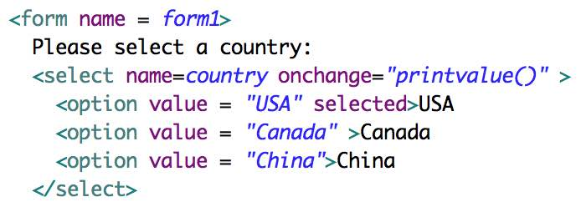
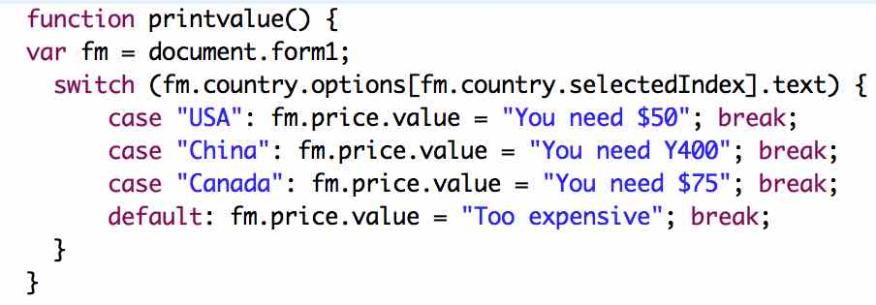
Single Page Application Site
event
Browser
HTML elements
HTML
JavaScript
HTTP request
HTTP response
Presentation
Logic
Data
Web server
Database
Advantages
Fast (load most resources once; only data are transmitted)
Disadvantages
Hard to maintain and reuse, cross-site scripting, memory leak

Slide 24
Summary: Web Apps
Deploy across the Web
Other (software) deployment methods include bundling, shrink-wrapping, embedding, and contracting
New technologies
New conceptual language constructs for programming
Integration
Data management
Control connections
Browser features
These differences affect every aspect of
how to engineer high quality software

